Slide 1


Here's your outline to get started
Key facts about your topic
A rocket engine uses stored rocket propellants as reaction mass for forming a high-speed propulsive jet of fluid, usually high-temperature gas. Rocket engines are reaction engines, producing thrust in accordance with Newton's third law. Most rocket engines use the combustion of reactive chemicals to supply the necessary energy, but non-combusting forms such as cold gas thrusters and nuclear thermal rockets also exist. Vehicles propelled by rocket engines are commonly called rockets. Rocket vehicles carry their own oxidizer, unlike most combustion engines, so rocket engines can be use...
Inventor: Robert H. Goddard, Konstantin Tsiolkovsky
See more: Open the Notes below for more information.
Notes:
QuickStarter has created an outline to help you get started on your presentation. Some slides include information here in the notes to provide additional topics for you to research.
Summary:
A rocket engine uses stored rocket propellants as reaction mass for forming a high-speed propulsive jet of fluid, usually high-temperature gas. Rocket engines are reaction engines, producing thrust in accordance with Newton's third law. Most rocket engines use the combustion of reactive chemicals to supply the necessary energy, but non-combusting forms such as cold gas thrusters and nuclear thermal rockets also exist. Vehicles propelled by rocket engines are commonly called rockets. Rocket vehicles carry their own oxidizer, unlike most combustion engines, so rocket engines can be used in a vacuum to propel spacecraft and ballistic missiles.

Slide 2
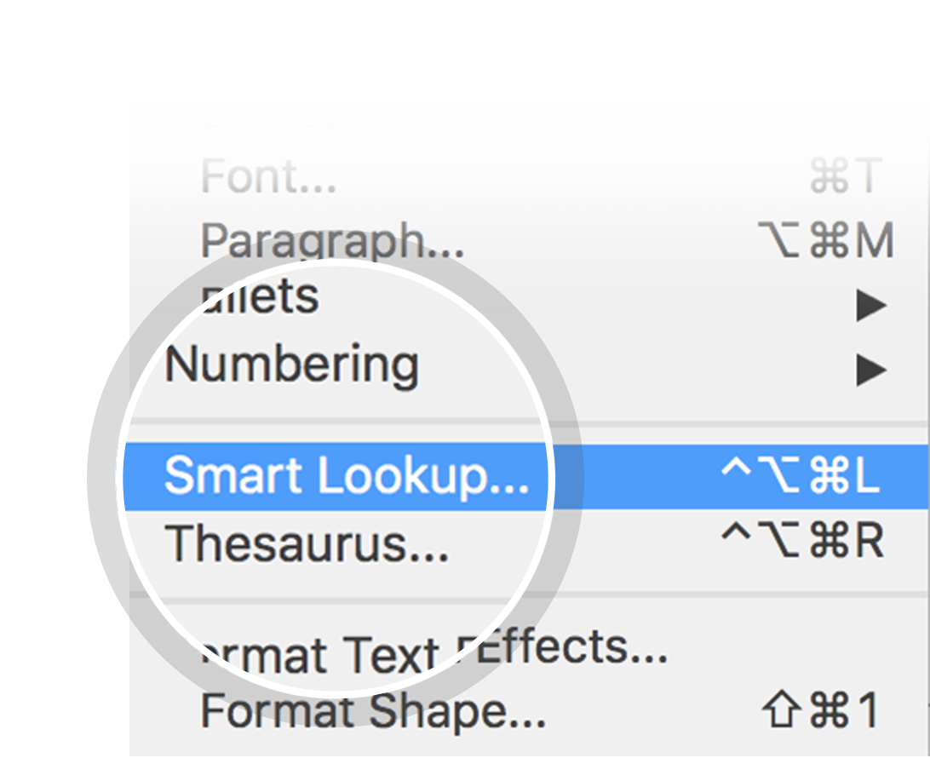
Related topics to research
Merlin
Rocket Propellant
Specific Impulse
Spacecraft Propulsion
Rocket Engine Nozzle
Tsiolkovsky rocket equation
Saturn V
RP-1
Staged Combustion Cycle
RS-68
Use Smart Lookup to learn more
1
Highlight one of the related topics
Right-click on the topic
Choose "Smart Lookup"
2
3

Slide 3
Rocket engine

Slide 4
Contents
Terminology
Principle of operation
Overall performance
Cooling
Mechanical issues
Acoustic issues
Testing
Safety
Chemistry
Ignition
Jet physics
Types of rocket engines
History of rocket engines

Slide 5
Terminology

Slide 6
Principle of operation
Look in the slide notes below for topics to consider talking about
Notes:
Consider talking about:
Propellant
Injection
Combustion chamber
Nozzle
Propellant efficiency
Thrust vectoring

Slide 7
Overall performance
Look in the slide notes below for topics to consider talking about
Notes:
Consider talking about:
Specific impulse
Vacuum specific impulse, Isp
Throttling
Energy efficiency
Thrust-to-weight ratio

Slide 8
Cooling

Slide 9
Mechanical issues

Slide 10
Acoustic issues
Look in the slide notes below for topics to consider talking about
Notes:
Consider talking about:
Combustion instabilities
Exhaust noise

Slide 11
Testing

Slide 12
Safety
Look in the slide notes below for topics to consider talking about
Notes:
Consider talking about:
Saturn family (1961–1975)
Space Shuttle (1981–2011)

Slide 13
Chemistry

Slide 14
Ignition

Slide 15
Jet physics

Slide 16
Types of rocket engines
Look in the slide notes below for topics to consider talking about
Notes:
Consider talking about:
Thermal
Nuclear

Slide 17
History of rocket engines

Slide 18
Works cited

